Slide 1
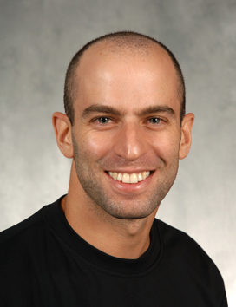
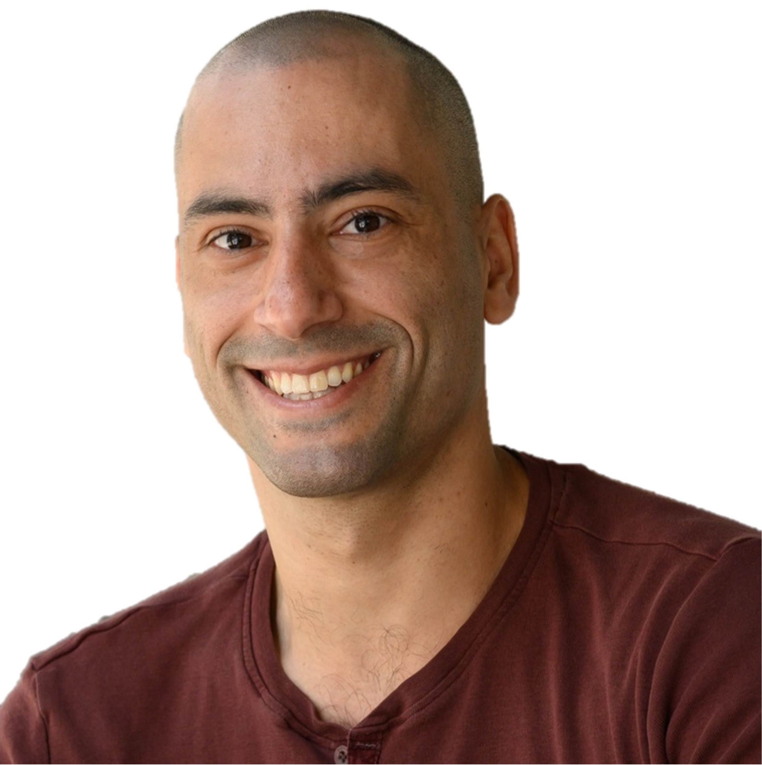


On Differential Privacy and Adaptive Data Analysis with Bounded Space
Itai Dinur
Uri Stemmer
David P. Woodruff
Samson Zhou

Slide 2

Streaming Model
Input: Elements of an underlying data set $S$, which arrives sequentially
Output: Evaluation (or approximation) of a given function
Goal: Use space sublinear in the size $m$of the input $S$
1 0 1 1 1 0 0 1

Slide 3
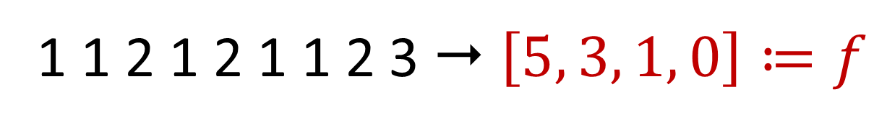

Frequency Vector
Given a set $S$ of $m$ elements from $[n]$, let $f_{i}$ be the frequency of element $i$. (How often it appears)
1 1 2 1 2 1 1 2 3  $\left[5, 3, 1, 0\right]≔f$

Slide 4
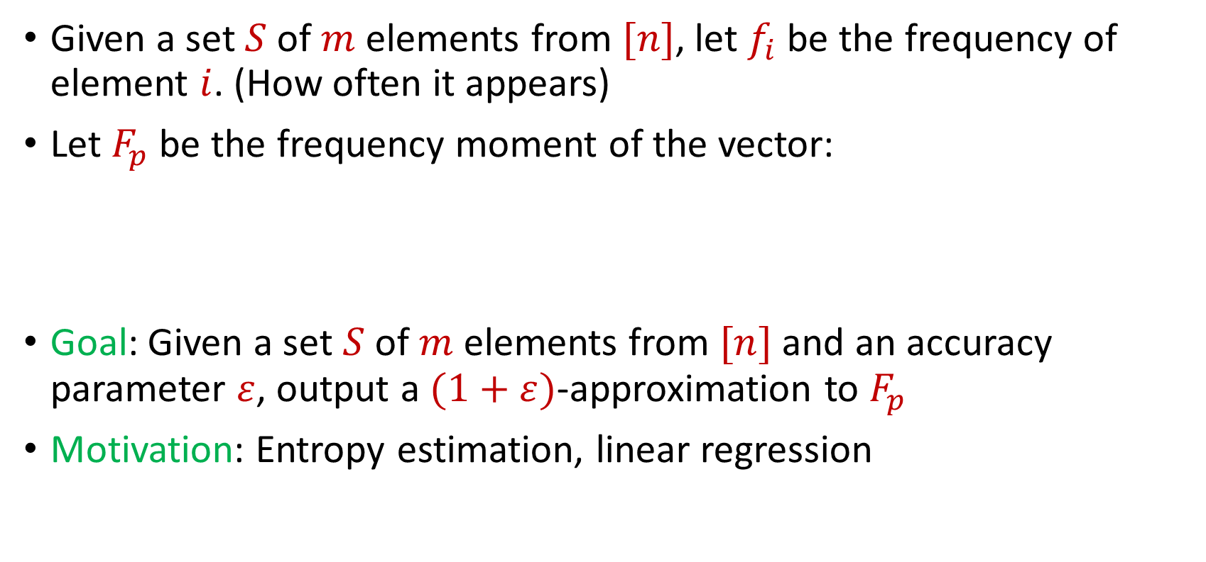
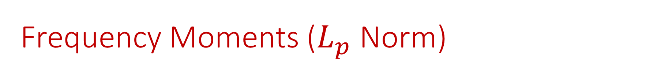
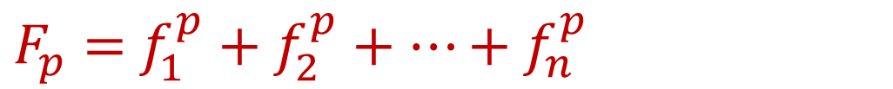
Frequency Moments ($L_{p}$ Norm)
Given a set $S$ of $m$ elements from $[n]$, let $f_{i}$ be the frequency of element $i$. (How often it appears)
Let $F_{p}$ be the frequency moment of the vector:
Goal: Given a set $S$ of $m$ elements from $[n]$ and an accuracy parameter $ε$, output a $(1+ε)$-approximation to $F_{p}$
Motivation: Entropy estimation, linear regression
$F_{p}=$ $f_{1}^{p}+f_{2}^{p}+…+f_{n}^{p}$

Slide 5
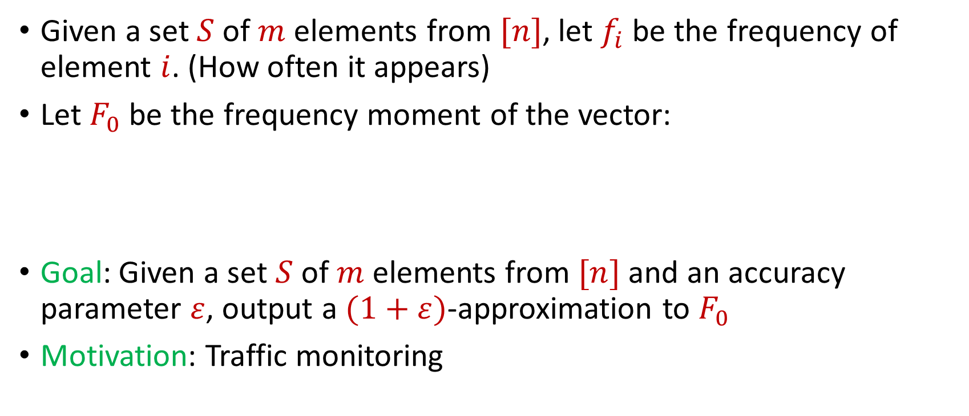

Distinct Elements ($F_{0}$ Estimation)
Given a set $S$ of $m$ elements from $[n]$, let $f_{i}$ be the frequency of element $i$. (How often it appears)
Let $F_{0}$ be the frequency moment of the vector:
Goal: Given a set $S$ of $m$ elements from $[n]$ and an accuracy parameter $ε$, output a $(1+ε)$-approximation to $F_{0}$
Motivation: Traffic monitoring
$F_{0}=$ $|\{i :f_{i}≠0\}|$

Slide 6
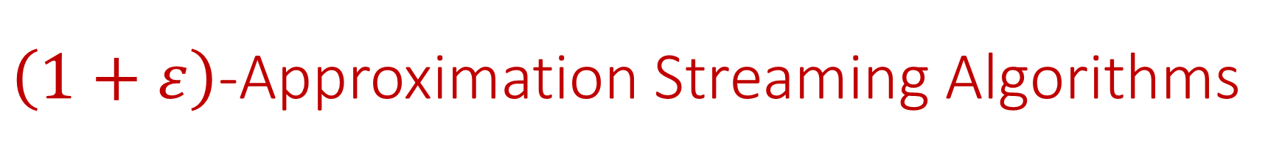
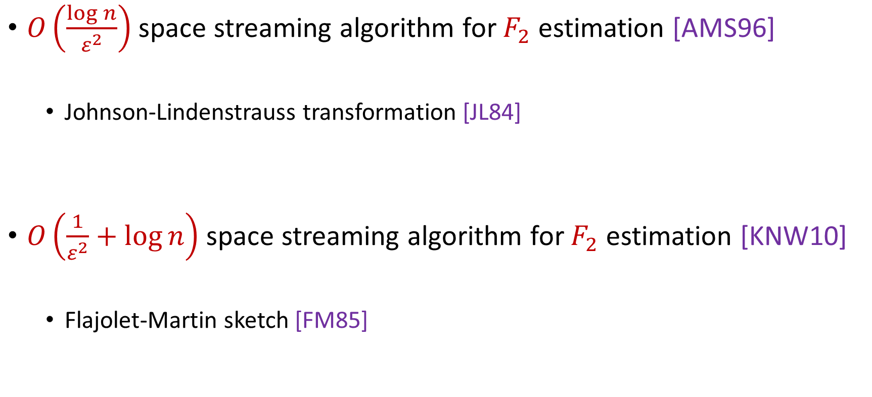
$\left(1+ε\right)$-Approximation Streaming Algorithms
$O\left(\frac{\log{n}}{ε^{2}}\right)$ space streaming algorithm for $F_{2}$ estimation [AMS96]
Johnson-Lindenstrauss transformation [JL84]
$O\left(\frac{1}{ε^{2}}+\log{n}\right)$ space streaming algorithm for $F_{2}$ estimation [KNW10]
Flajolet-Martin sketch [FM85]
Notes:
[KaneNelsonWoodruff10], [Blasiok20], [BlasiokDingNelson17], [Ganguly11, GangulyWoodruff18], [BravermanChestnutIvkinNelsonWangWoodruff17]

Slide 7




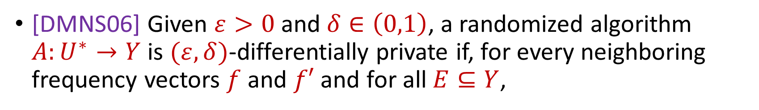

Differential Privacy
[DMNS06] Given $ε>0$and $δ∈\left(0,1\right)$, a randomized algorithm $A:U^{∗}→Y$ is $(ε,δ)$-differentially private if, for every neighboring frequency vectors $f$ and $f′$ and for all $E⊆Y$,
$$Pr\left[A\left(f\right)∈E\right]≤e^{ε}Pr\left[A\left(f^{′}\right)∈E\right]+δ$$
$$A\left( \right)≈A\left( \right)$$
Notes:
[DworkMcSherryNissimSmith06]

Slide 8
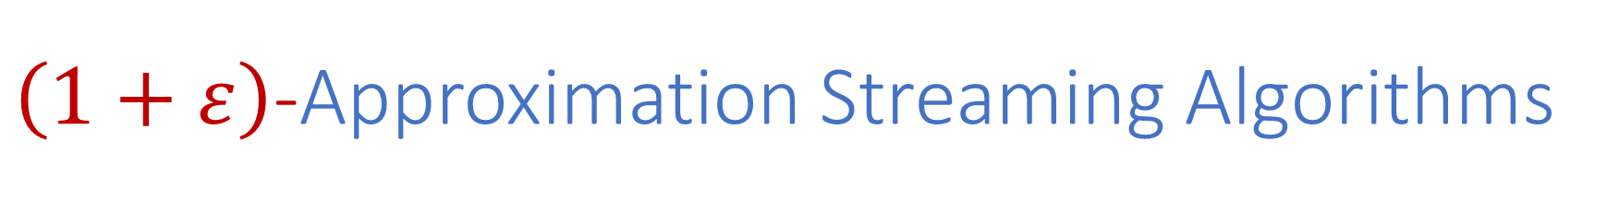
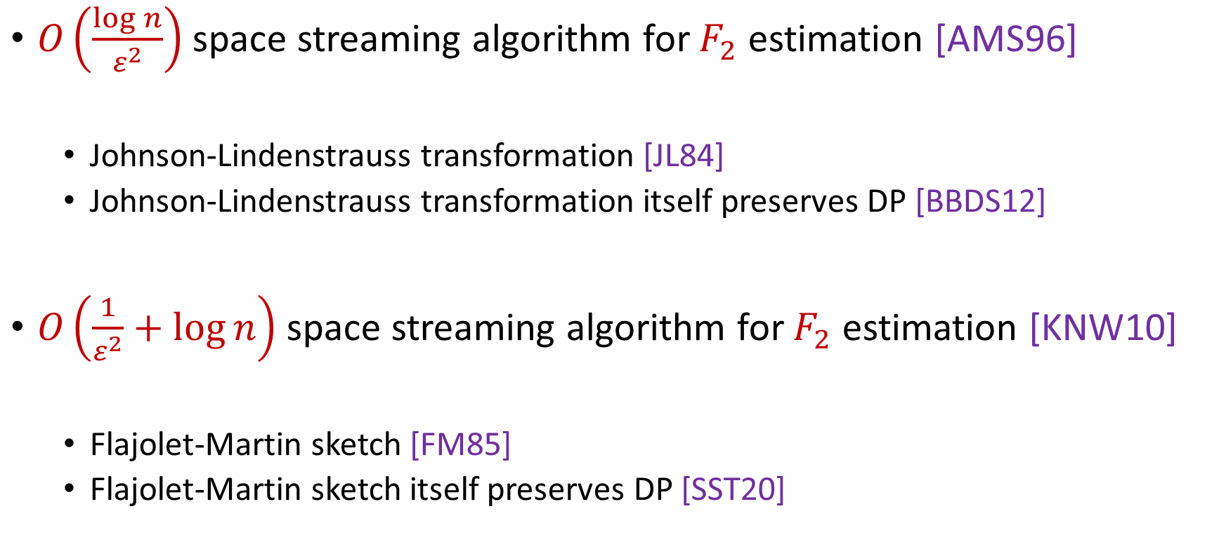
$\left(1+ε\right)$-Approximation Streaming Algorithms
$O\left(\frac{\log{n}}{ε^{2}}\right)$ space streaming algorithm for $F_{2}$ estimation [AMS96]
Johnson-Lindenstrauss transformation [JL84]
Johnson-Lindenstrauss transformation itself preserves DP [BBDS12]
$O\left(\frac{1}{ε^{2}}+\log{n}\right)$ space streaming algorithm for $F_{2}$ estimation [KNW10]
Flajolet-Martin sketch [FM85]
Flajolet-Martin sketch itself preserves DP [SST20]
Notes:
[KaneNelsonWoodruff10], [Blasiok20], [BlasiokDingNelson17], [Ganguly11, GangulyWoodruff18], [BravermanChestnutIvkinNelsonWangWoodruff17]

Slide 9

$\left(1+ε\right)$-Approximation Streaming Algorithms
Does differential privacy cost more space?
$O\left(\frac{\log{n}}{ε^{2}}\right)$ space streaming algorithm for $F_{2}$ estimation [AMS96]
Johnson-Lindenstrauss transformation [JL84]
Johnson-Lindenstrauss transformation itself preserves DP [BBDO12]
$O\left(\frac{1}{ε^{2}}+\log{n}\right)$ space streaming algorithm for $F_{2}$ estimation [KNW10]
Flajolet-Martin sketch [FM85]
Flajolet-Martin sketch itself preserves DP [SST20]
Notes:
[KaneNelsonWoodruff10], [Blasiok20], [BlasiokDingNelson17], [Ganguly11, GangulyWoodruff18], [BravermanChestnutIvkinNelsonWangWoodruff17]

Slide 10
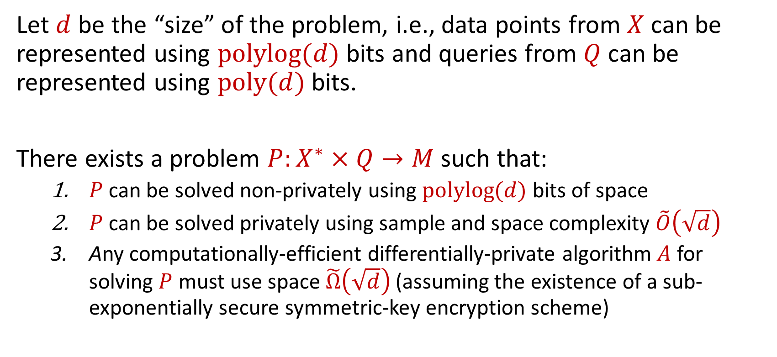
Our Results (Differential Privacy)
Let $d$ be the “size” of the problem, i.e., data points from $X$ can be represented using $\operatorname{polylog}{(d)}$ bits and queries from $Q$ can be represented using $poly(d)$ bits.
There exists a problem $P:X^{∗}×Q→M$ such that:
$P$ can be solved non-privately using $\operatorname{polylog}{(d)}$ bits of space
$P$ can be solved privately using sample and space complexity $\tilde{O}\left(\sqrt{d}\right)$
Any computationally-efficient differentially-private algorithm $A$ for solving $P$ must use space $\tilde{Ω}\left(\sqrt{d}\right)$ (assuming the existence of a sub-exponentially secure symmetric-key encryption scheme)
Notes:
[DworkMcSherryNissimSmith06]

Slide 11








Adaptive Data Analysis
$$P$$
$$S∼P$$
Notes:
[DworkMcSherryNissimSmith06]

Slide 12
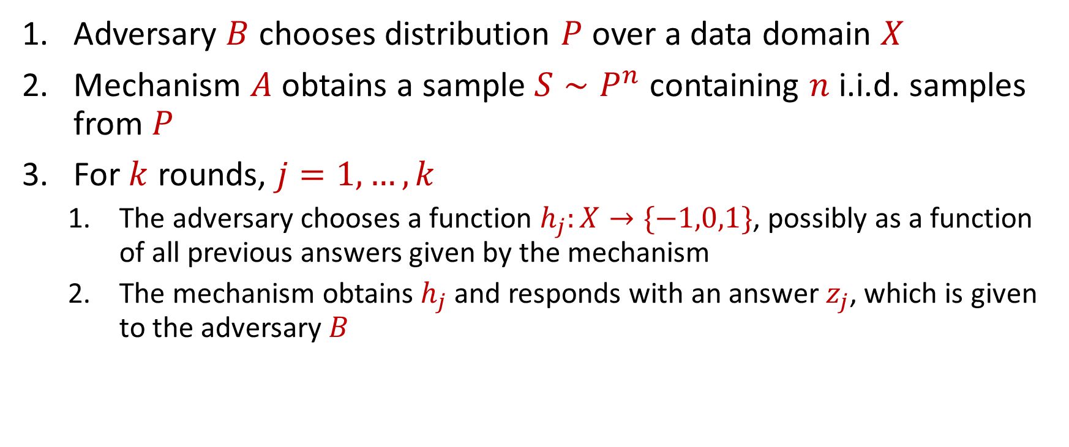
Adaptive Data Analysis
Adversary $B$ chooses distribution $P$ over a data domain $X$
Mechanism $A$ obtains a sample $S∼P^{n}$ containing $n$ i.i.d. samples from $P$
For $k$ rounds, $j=1,…,k$
The adversary chooses a function $h_{j}:X→\{−1,0,1\}$, possibly as a function of all previous answers given by the mechanism
The mechanism obtains $h_{j}$and responds with an answer $z_{j}$, which is given to the adversary $B$

Slide 13
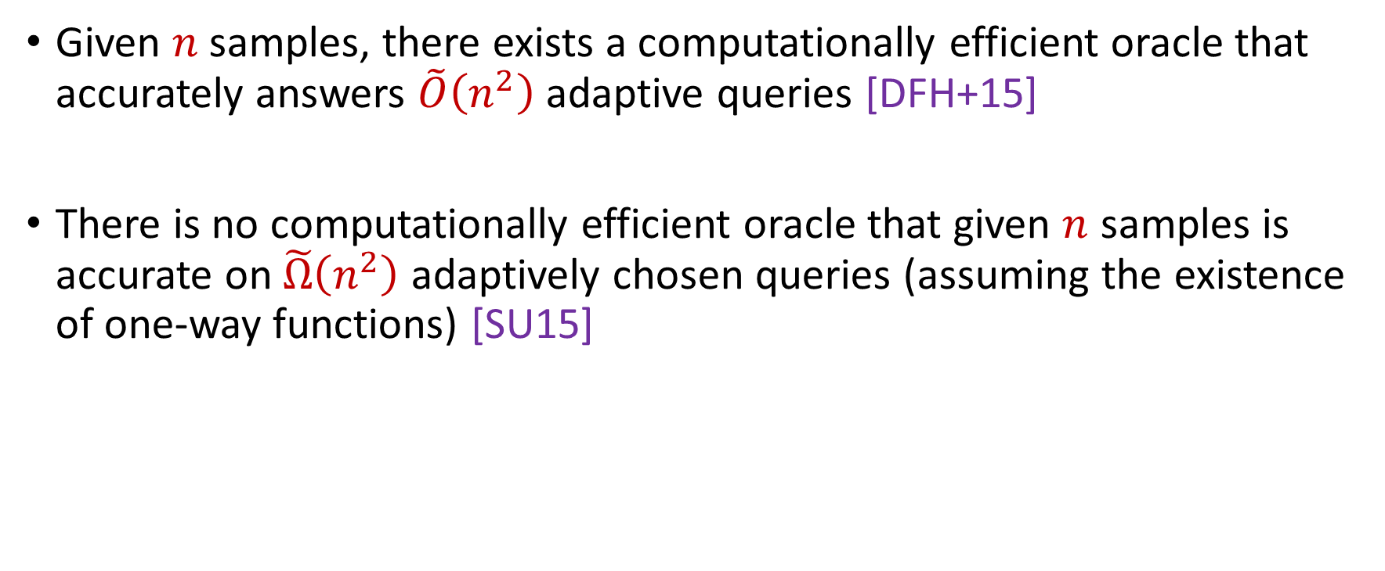
Adaptive Data Analysis
Given $n$samples, there exists a computationally efficient oracle that accurately answers $\tilde{O}\left(n^{2}\right)$ adaptive queries [DFH+15]
There is no computationally efficient oracle that given $n$ samples is accurate on $\tilde{Ω}\left(n^{2}\right)$ adaptively chosen queries (assuming the existence of one-way functions) [SU15]

Slide 14

Adaptive Data Analysis
Is there a more fundamental bottleneck for the ADA problem than the number of samples?
Given $n$samples, there exists a computationally efficient oracle that accurately answers $\tilde{O}\left(n^{2}\right)$ adaptive queries [DFH+15]
There is no computationally efficient oracle that given $n$ samples is accurate on $\tilde{Ω}\left(n^{2}\right)$ adaptively chosen queries (assuming the existence of one-way functions)

Slide 15

Our Results (Adaptive Data Analysis)
Every computationally efficient mechanism that is $(0.1, 0.1)$-accurate for $k$ queries must have space complexity at least $Ω(\sqrt{k})$, assuming the existence of one-way functions
Notes:
[DworkMcSherryNissimSmith06]

Slide 16










Query vs. Communication
$$f(x)$$
$$f(y∘z)$$
$$x_{2}$$
$$A_{1}(y)$$
0
1
0
1
$$x_{3}$$
$$B_{2}(z)$$
$$x_{1}$$
$$B_{1}(z)$$
0
1
0
1
0
1
0
1
0
1
0
1
$$x_{5}$$
$$A_{2}(y)$$
1
0
1
1
0
1
1
0
1
0
Decision Tree
Communication Protocol

Slide 17
Talk Structure
Multi-instance leakage-resilient (MILR) scheme definition
Differential privacy separation
Space bounded adaptive data analysis
Construction of MILR
Notes:
[DworkMcSherryNissimSmith06]

Slide 18

Questions?

Slide 19
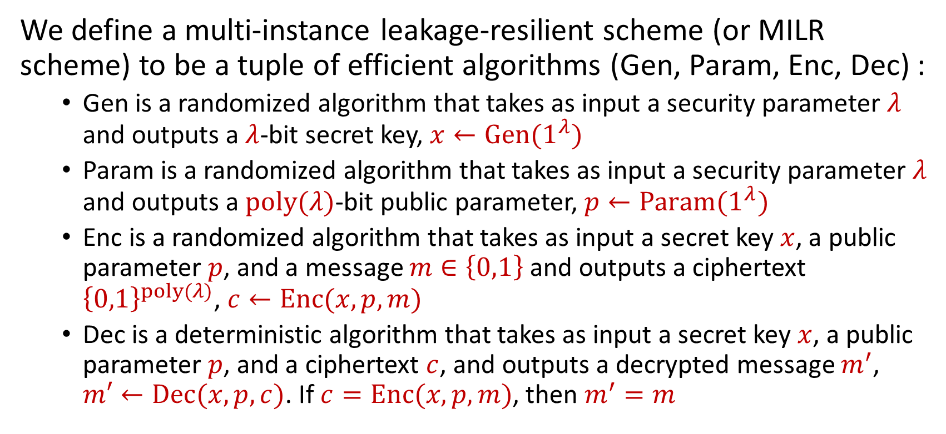
Multi-Instance Leakage-Resilient Scheme
We define a multi-instance leakage-resilient scheme (or MILR scheme) to be a tuple of efficient algorithms (Gen, Param, Enc, Dec) :
Gen is a randomized algorithm that takes as input a security parameter $λ$ and outputs a $λ$-bit secret key, $x←Gen(1^{λ})$
Param is a randomized algorithm that takes as input a security parameter $λ$ and outputs a $poly(λ)$-bit public parameter, $p←Param(1^{λ})$
Enc is a randomized algorithm that takes as input a secret key $x$, a public parameter $p$, and a message $m∈\left\{0,1\right\}$ and outputs a ciphertext ${\left\{0,1\right\}}^{poly(λ)}$, $c←Enc(x,p,m)$
Dec is a deterministic algorithm that takes as input a secret key $x$, a public parameter $p$, and a ciphertext $c$, and outputs a decrypted message $m^{′}$, $m′←Dec(x,p,c)$. If $c=Enc(x,p,m)$, then $m^{′}=m$
Notes:
[DworkMcSherryNissimSmith06]

Slide 20

Multi-Instance Leakage-Resilient Scheme
An MILR scheme (Gen, Param, Enc, Dec) is $(Γ,\overline{τ})$-secure against space bounded pre-processing adversaries if both multi-semantic security and multi-security against bounded pre-processing adversary hold
Notes:
[DworkMcSherryNissimSmith06]

Slide 21
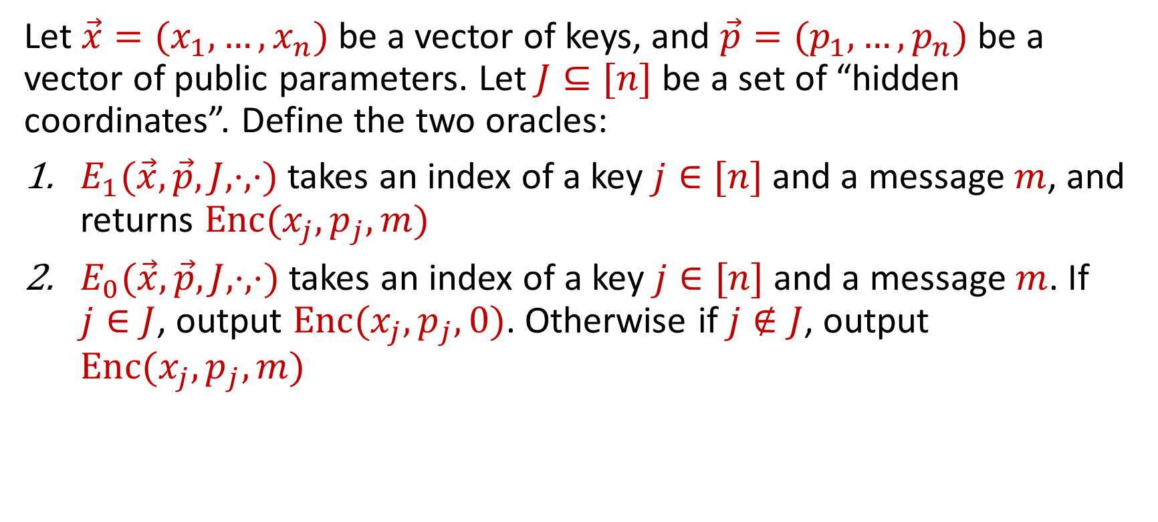
Multi-Instance Leakage-Resilient Scheme
Let $\vec{x}=(x_{1},…,x_{n})$ be a vector of keys, and $\vec{p}=(p_{1},…,p_{n})$be a vector of public parameters. Let $J⊆[n]$ be a set of “hidden coordinates”. Define the two oracles:
$E_{1}(\vec{x},\vec{p},J,⋅,⋅)$ takes an index of a key $j∈[n]$ and a message $m$, and returns $Enc(x_{j},p_{j},m)$
$E_{0}(\vec{x},\vec{p},J,⋅,⋅)$ takes an index of a key $j∈[n]$ and a message $m$. If $j∈J$, output $Enc(x_{j},p_{j},0)$. Otherwise if $j∉J$, output $Enc(x_{j},p_{j},m)$
Notes:
[DworkMcSherryNissimSmith06]

Slide 22


Multi-Semantic Security
Given $Γ:R→R$, every $n=poly(Γ\left(λ\right))$ and every $poly(Γ\left(λ\right))$-time adversary $B$, there exists negligible function $negl$
“A computationally bounded adversary that gets the public parameters but not the keys, cannot tell whether it is interacting with $E_{0}$ or with $E_{1}$”
$$\left|\underset{\vec{x},\vec{p},B,Enc}{Pr}\left[B^{E_{0}\left(\vec{x},\vec{p},\left[n\right],⋅,⋅\right)}\left(\vec{p}\right)=1\right]−\underset{\vec{x},\vec{p},B,Enc}{Pr}\left[B^{E_{0}\left(\vec{x},\vec{p},\left[n\right],⋅,⋅\right)}\left(\vec{p}\right)=1\right]\right|$$
$≤negl$ $(Γ\left(λ\right))$
Notes:
[DworkMcSherryNissimSmith06]

Slide 23


Multi-Security Against Bounded Pre-Processing Adversary
Given $Γ:R→R$, every $n=poly\left(Γ\left(λ\right)\right)$, pre-processing function $F$ that outputs $z←F(\vec{x})$ with $\left|z\right|≤s$, we can output a random $J⊆[n]$ with $\left|J\right|≥n−\overline{τ}(λ,s)$ such that for every $poly(Γ\left(λ\right))$-time adversary $B$, there exists negligible function $negl$
“Even if $s$ bits of our $n$ keys are leaked then still encryptions w.r.t. the keys of $J$ are computationally indistinguishable”
$$\left|\underset{\vec{x},\vec{p},B,Enc,J,z}{Pr}\left[B^{E_{0}\left(\vec{x},\vec{p},J,⋅,⋅\right)}\left(z,\vec{p}\right)=1\right]−\underset{\vec{x},\vec{p},B,Enc,J,z}{Pr}\left[B^{E_{0}\left(\vec{x},\vec{p},J,⋅,⋅\right)}\left(z,\vec{p}\right)=1\right]\right|$$
$≤negl$ $(Γ\left(λ\right))$
Notes:
[DworkMcSherryNissimSmith06]

Slide 24
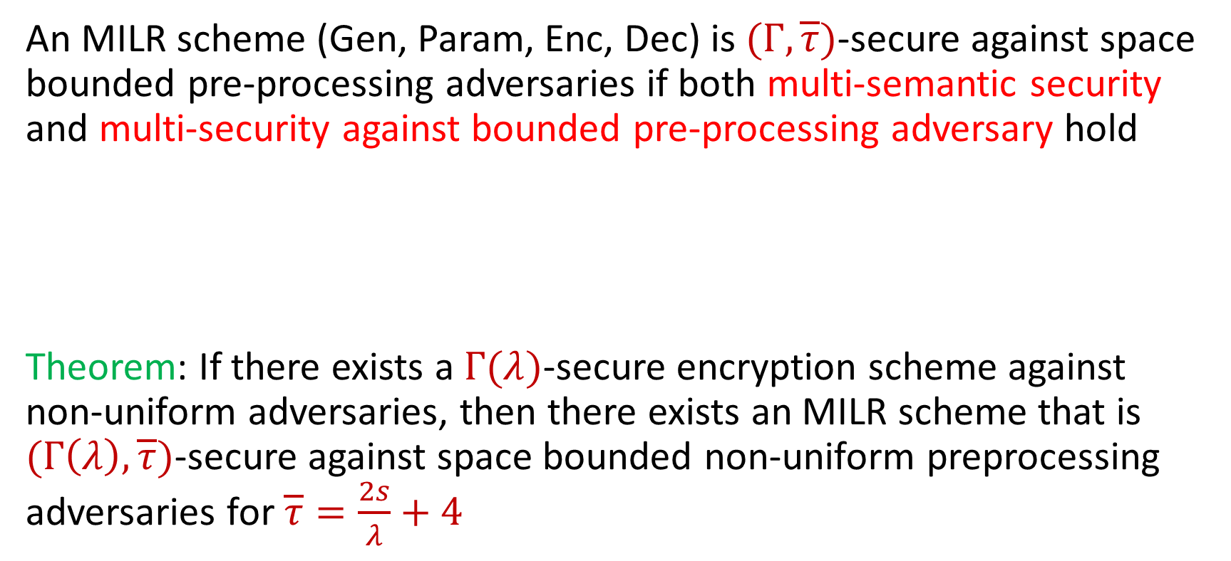
Multi-Instance Leakage-Resilient Scheme
An MILR scheme (Gen, Param, Enc, Dec) is $(Γ,\overline{τ})$-secure against space bounded pre-processing adversaries if both multi-semantic security and multi-security against bounded pre-processing adversary hold
Theorem: If there exists a $Γ(λ)$-secure encryption scheme against non-uniform adversaries, then there exists an MILR scheme that is $(Γ\left(λ\right),\overline{τ})$-secure against space bounded non-uniform preprocessing adversaries for $\overline{τ}=\frac{2s}{λ}+4$
Notes:
[DworkMcSherryNissimSmith06]

Slide 25

Multi-Instance Leakage-Resilient Scheme
Intuition: Any good $s$-space-bounded adversary against an MILR can be viewed as a convex combination of adversaries that store $O\left(\frac{s}{λ}\right)$ samples
Notes:
[DworkMcSherryNissimSmith06]

Slide 26
Talk Structure
Multi-instance leakage-resilient (MILR) scheme definition
Differential privacy separation
Space bounded adaptive data analysis
Construction of MILR
Notes:
[DworkMcSherryNissimSmith06]

Slide 27
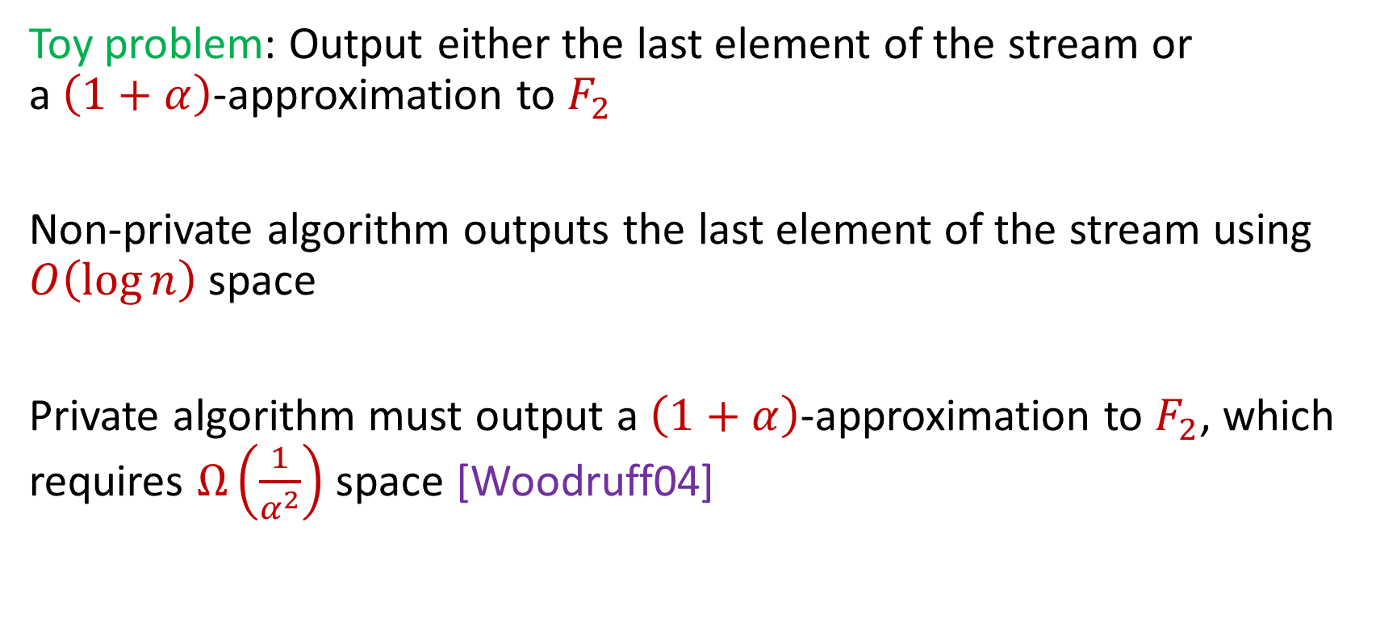
Space Hardness for Differential Privacy
Toy problem: Output either the last element of the stream or a$\left(1+α\right)$-approximation to $F_{2}$
Non-private algorithm outputs the last element of the stream using $O\left(\log{n}\right)$ space
Private algorithm must output a $\left(1+α\right)$-approximation to $F_{2}$, which requires $Ω\left(\frac{1}{α^{2}}\right)$ space [Woodruff04]
Notes:
[DworkMcSherryNissimSmith06]

Slide 28
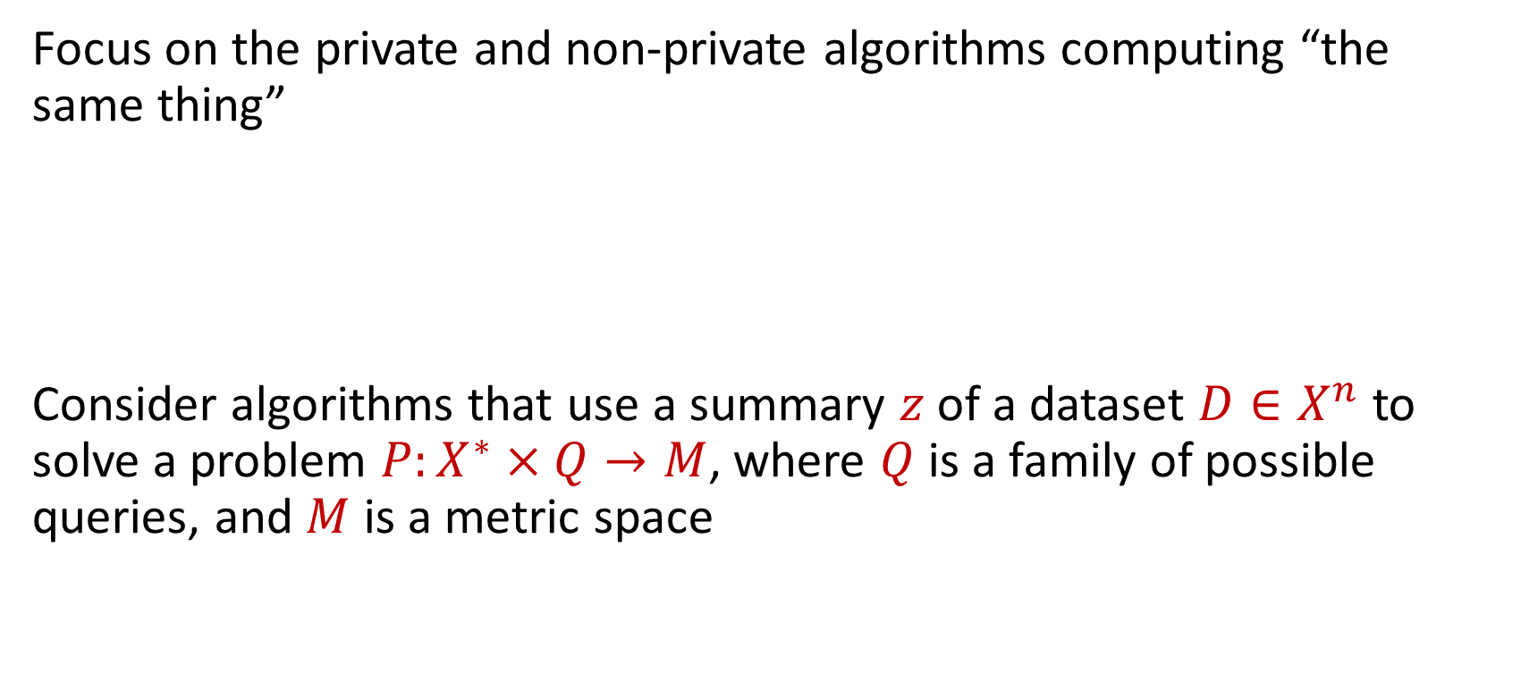
Space Hardness for Differential Privacy
Focus on the private and non-private algorithms computing “the same thing”
Consider algorithms that use a summary $z$ of a dataset $D∈X^{n}$ to solve a problem $P:X^{∗}×Q→M$, where $Q$ is a family of possible queries, and $M$ is a metric space
Notes:
[DworkMcSherryNissimSmith06]

Slide 29
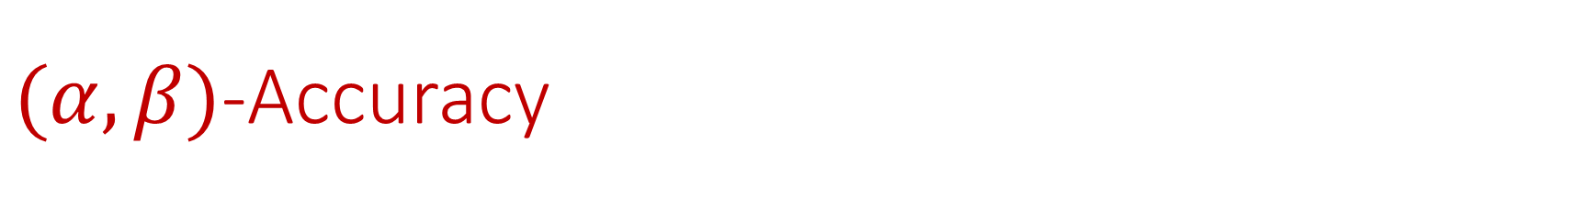

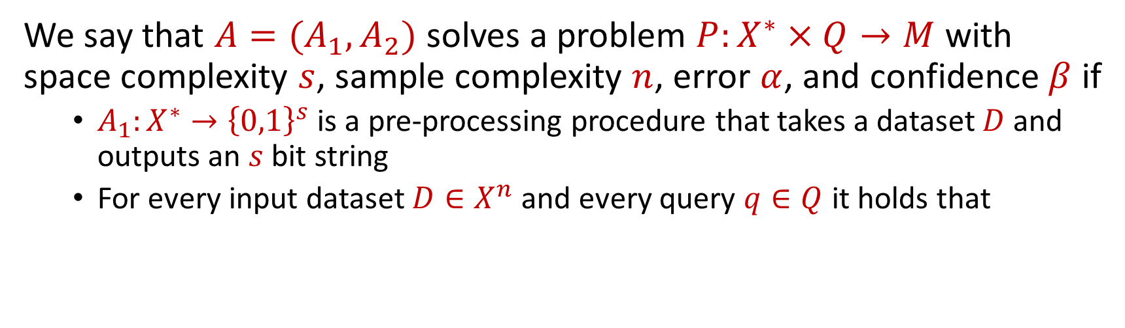
$(α,β)$-Accuracy
We say that $A=(A_{1},A_{2})$ solves a problem $P:X^{∗}×Q→M$ with space complexity $s$, sample complexity $n$, error $α$, and confidence $β$ if
$A_{1}:X^{∗}→{\left\{0,1\right\}}^{s}$ is a pre-processing procedure that takes a dataset $D$ and outputs an $s$ bit string
For every input dataset $D∈X^{n}$ and every query $q∈Q$ it holds that
$$\underset{\begin{aligned}z←A_{1}(D) \\ a←A_{2}(z,q)\end{aligned}}{Pr}\left[\left|a−P\left(D,q\right)\right|≤α\right]≤β$$
Notes:
[DworkMcSherryNissimSmith06]

Slide 30
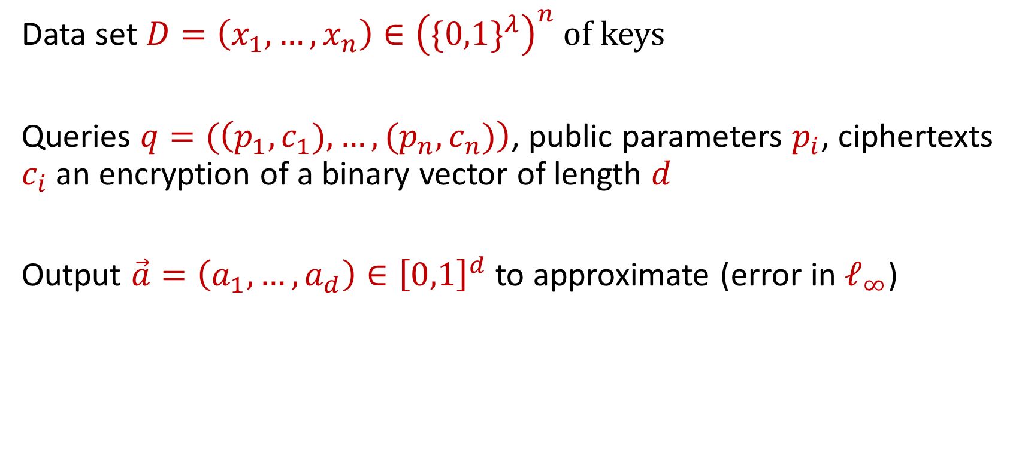

Decrypted Average Vector (DAV)
Data set $D=\left(x_{1},…,x_{n}\right)∈{\left(\{0,1\}^{λ}\right)}^{n}$ of keys
Queries $q=(\left(p_{1},c_{1}),…,{(p}_{n},c_{n})\right)$, public parameters $p_{i}$, ciphertexts $c_{i}$ an encryption of a binary vector of length $d$
Output $\vec{a}=\left(a_{1},…,a_{d}\right)∈{\left[0,1\right]}^{d}$ to approximate (error in $ℓ_{∞}$)
$$dav_{q}\left(D\right)=\frac{1}{n}\sum_{i=1}^{n}{Dec(x_{i}, p_{i}, c_{i})}$$
Notes:
[DworkMcSherryNissimSmith06]

Slide 31
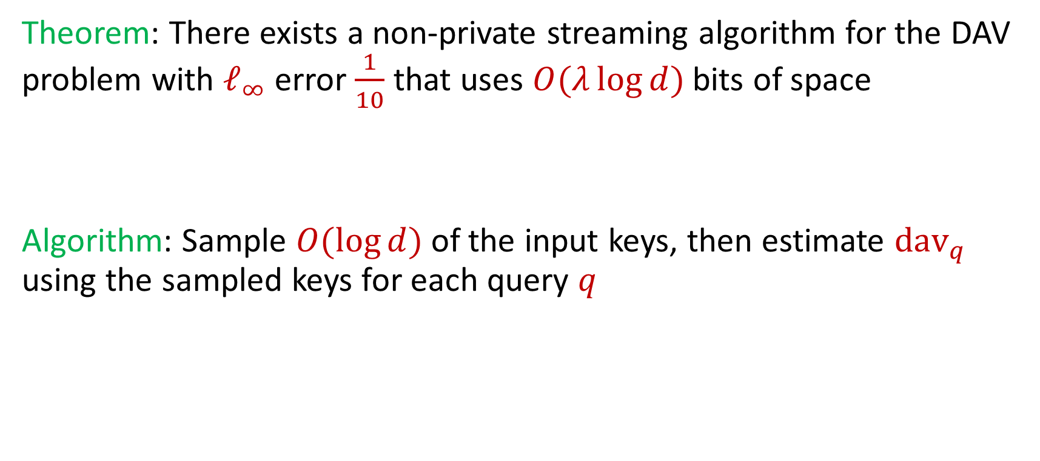
Decrypted Average Vector (DAV)
Theorem: There exists a non-private streaming algorithm for the DAV problem with $ℓ_{∞}$ error $\frac{1}{10}$ that uses $O(λ\log{d})$ bits of space
Algorithm: Sample $O(\log{d})$of the input keys, then estimate $dav_{q}$ using the sampled keys for each query $q$
Notes:
[DworkMcSherryNissimSmith06]

Slide 32
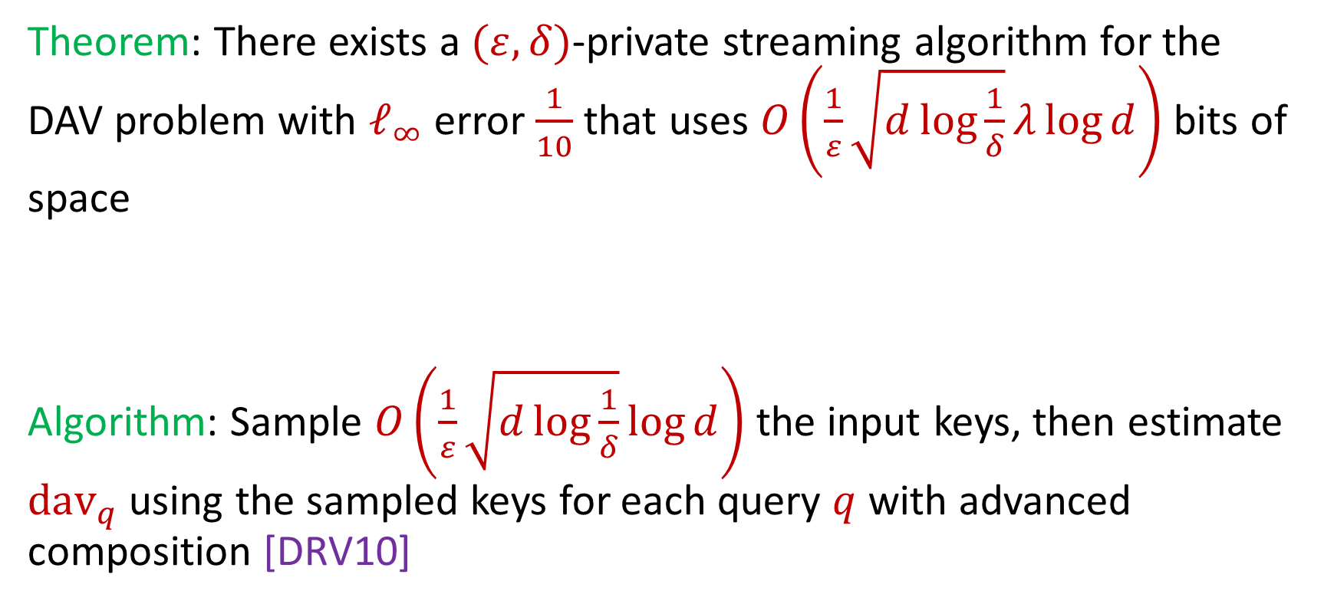
Decrypted Average Vector (DAV)
Theorem: There exists a $(ε,δ)$-private streaming algorithm for the DAV problem with $ℓ_{∞}$ error $\frac{1}{10}$ that uses $O\left(\frac{1}{ε}\sqrt{d\log{\frac{1}{δ}}}λ\log{d}\right)$ bits of space
Algorithm: Sample $O\left(\frac{1}{ε}\sqrt{d\log{\frac{1}{δ}}}\log{d}\right)$ the input keys, then estimate $dav_{q}$ using the sampled keys for each query $q$ with advanced composition [DRV10]
Notes:
[DworkMcSherryNissimSmith06]

Slide 33
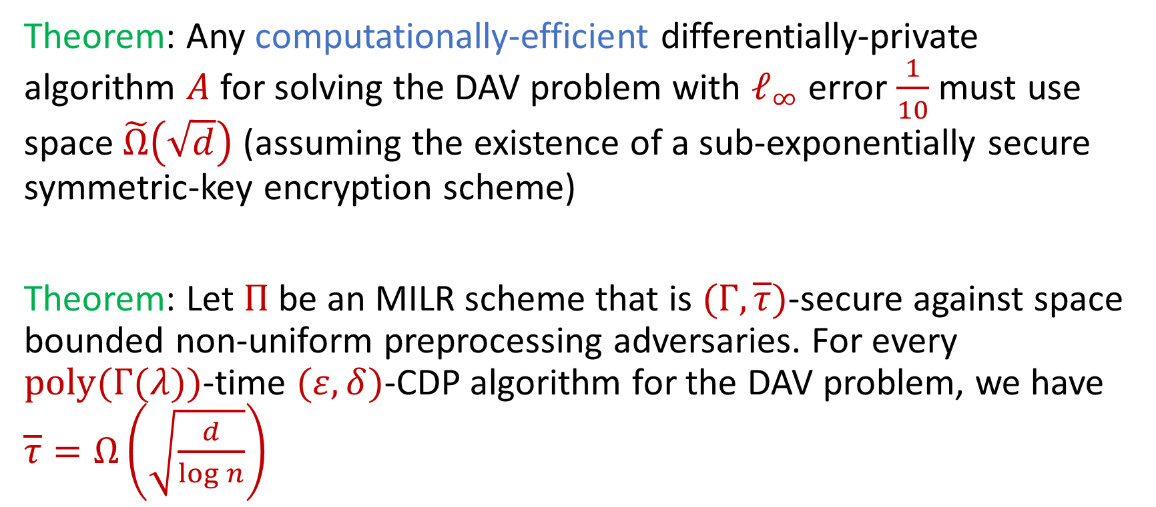
Decrypted Average Vector (DAV)
Theorem: Any computationally-efficient differentially-private algorithm $A$ for solving the DAV problem with $ℓ_{∞}$ error $\frac{1}{10}$ must use space $\tilde{Ω}\left(\sqrt{d}\right)$ (assuming the existence of a sub-exponentially secure symmetric-key encryption scheme)
Theorem: Let $Π$ be an MILR scheme that is $(Γ,\overline{τ})$-secure against space bounded non-uniform preprocessing adversaries. For every $poly(Γ(λ))$-time $(ε,δ)$-CDP algorithm for the DAV problem, we have $\overline{τ}=Ω\left(\sqrt{\frac{d}{\log{n}}}\right)$
Notes:
[DworkMcSherryNissimSmith06]

Slide 34
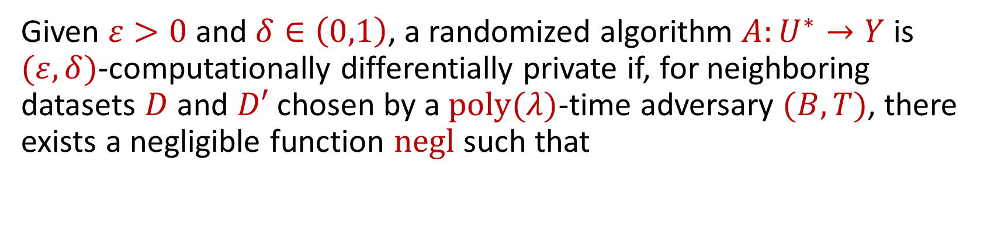
Computational Differential Privacy
Given $ε>0$and $δ∈\left(0,1\right)$, a randomized algorithm $A:U^{∗}→Y$ is $(ε,δ)$-computationally differentially private if, for neighboring datasets $D$ and $D′$ chosen by a $poly(λ)$-time adversary $(B,T)$, there exists a negligible function $negl$ such that
$$\underset{\left(D_{0},D_{1}\right)←Q}{Pr}\left[T\left(A\left(D_{0}\right)\right)=1\right]≤e^{ε}\underset{\left(D_{0},D_{1}\right)←Q}{Pr}\left[T\left(A\left(D_{1}\right)\right)=1\right]+δ+negl(λ)$$
Notes:
[DworkMcSherryNissimSmith06]

Slide 35
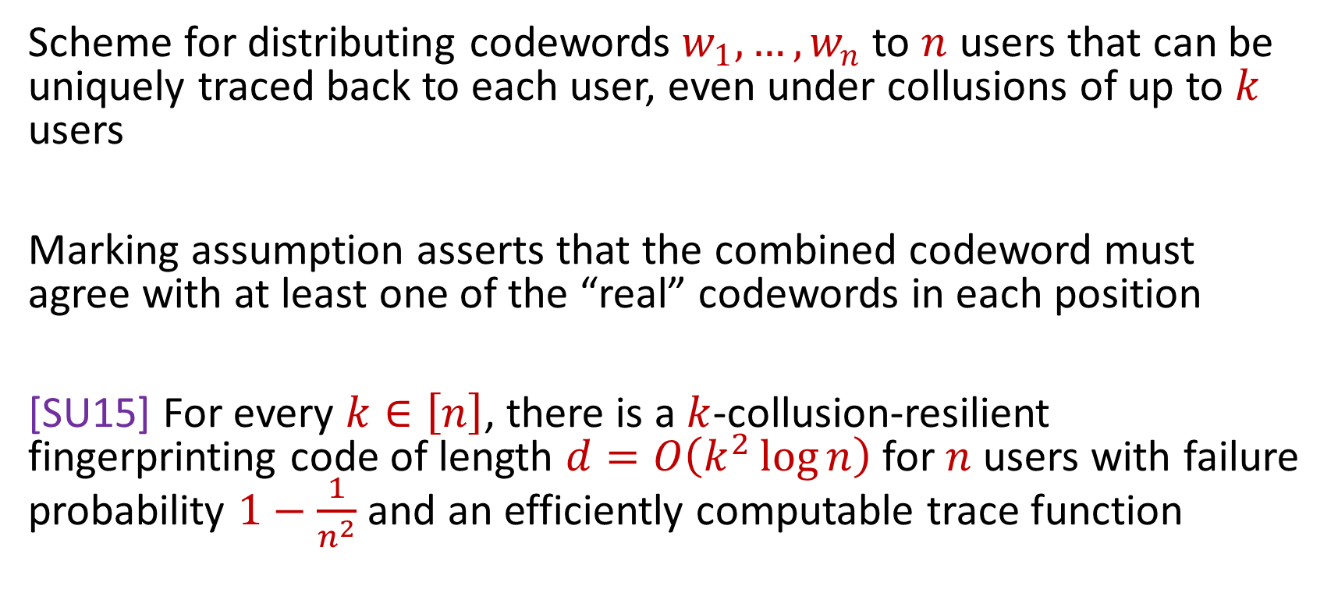
Fingerprinting Codes
Scheme for distributing codewords $w_{1},…, w_{n}$to $n$ users that can be uniquely traced back to each user, even under collusions of up to $k$ users
Marking assumption asserts that the combined codeword must agree with at least one of the “real” codewords in each position
[SU15] For every $k∈\left[n\right]$, there is a $k$-collusion-resilient fingerprinting code of length $d=O\left(k^{2}\log{n}\right)$ for $n$ users with failure probability $1−\frac{1}{n^{2}}$ and an efficiently computable trace function
Notes:
[DworkMcSherryNissimSmith06]

Slide 36
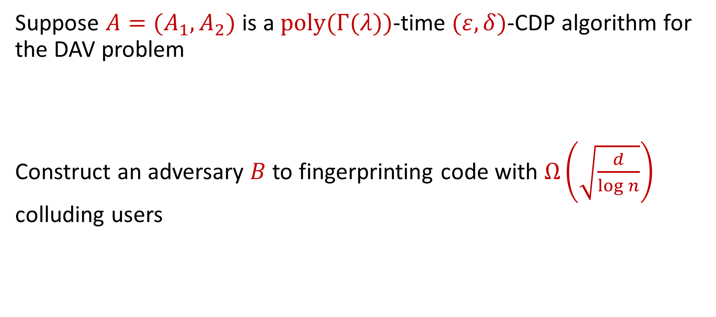
CDP Separation
Suppose $A=(A_{1},A_{2})$ is a $poly(Γ(λ))$-time $(ε,δ)$-CDP algorithm for the DAV problem
Construct an adversary $B$ to fingerprinting code with $Ω\left(\sqrt{\frac{d}{\log{n}}}\right)$ colluding users
Notes:
[DworkMcSherryNissimSmith06]

Slide 37
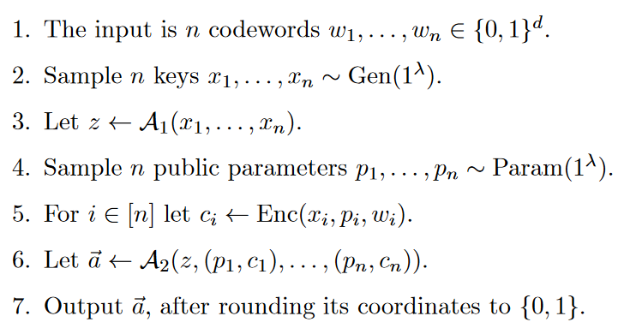
Adversary to FPC

Slide 38
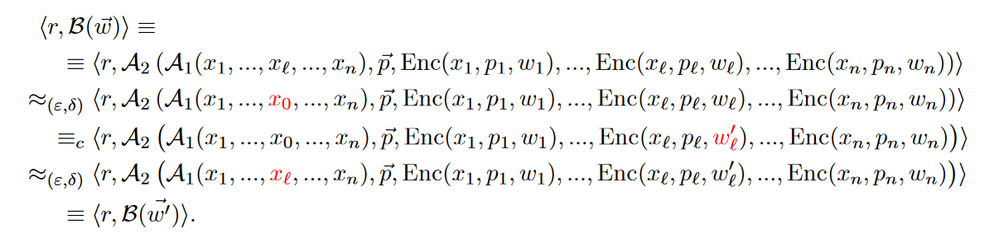
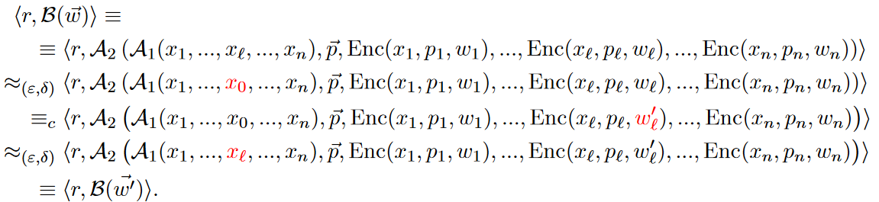

Proof Outline
Show $B$ is computationally differentially private w.r.t. the collection of codewords (even though our assumption on $A$ is that it is private w.r.t. the keys)
Notes:
[DworkMcSherryNissimSmith06]

Slide 39

Proof Outline
Leveraging the properties of the MILR scheme, show that $B$ effectively ignores most of its inputs, except for at most $\overline{τ}$ codewords, so $B$ is effectively an FPC adversary that operates on only $\overline{τ}$ codewords (rather than the $n$ codewords it obtains as input)
Notes:
[DworkMcSherryNissimSmith06]

Slide 41

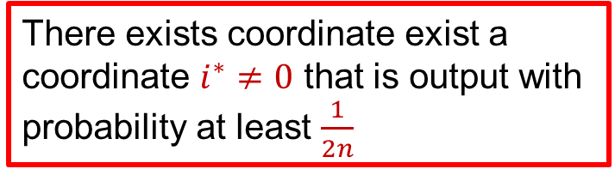
Proof Outline
A successful FPC adversary cannot be differentially private, because this would contradict the fact that the tracing algorithm is able to recover one of its input points [BUV14].
There exists coordinate exist a coordinate $i^{∗}≠0$ that is output with probability at least $\frac{1}{2n}$
FPC fails with probability at least $\frac{1}{2n}$
Notes:
[DworkMcSherryNissimSmith06]

Slide 42

Proof Outline
Our gain comes from the fact that $B$ only uses (effectively) $τ$ codewords, and hence, in order to get a contradiction, it suffices to use an FPC with a much shorter codeword-length
Notes:
[DworkMcSherryNissimSmith06]

Slide 43
Talk Structure
Multi-instance leakage-resilient (MILR) scheme definition
Differential privacy separation
Space bounded adaptive data analysis
Construction of MILR
Notes:
[DworkMcSherryNissimSmith06]

Slide 44
Questions?

Slide 45
Adaptive Data Analysis
Given $n$samples, there exists a computationally efficient oracle that accurately answers $\tilde{O}\left(n^{2}\right)$ adaptive queries [DFH+15]
There is no computationally efficient oracle that given $n$ samples is accurate on $\tilde{Ω}\left(n^{2}\right)$ adaptively chosen queries (assuming the existence of one-way functions) [SU15]

Slide 46

Our Results (Adaptive Data Analysis)
Theorem: Every computationally efficient mechanism that is $(0.1, 0.1)$-accurate for $k$ queries must have space complexity at least $Ω(\sqrt{k})$, assuming the existence of one-way functions
Notes:
[DworkMcSherryNissimSmith06]

Slide 47
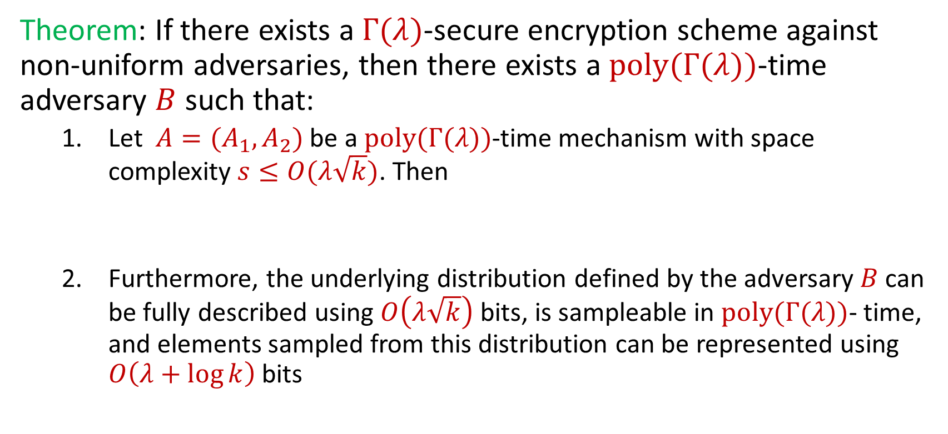
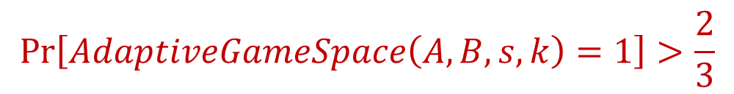
Space Hardness for Adaptive Data Analysis
Theorem: If there exists a $Γ(λ)$-secure encryption scheme against non-uniform adversaries, then there exists a $poly(Γ(λ))$-time adversary $B$ such that:
Let $A=(A_{1},A_{2})$ be a $poly(Γ(λ))$-time mechanism with space complexity $s≤O(λ\sqrt{k})$. Then
Furthermore, the underlying distribution defined by the adversary $B$ can be fully described using $O\left(λ\sqrt{k}\right)$ bits, is sampleable in $poly(Γ(λ))$- time, and elements sampled from this distribution can be represented using $O\left(λ+\log{k}\right)$bits
$$\operatorname{Pr}\left[AdaptiveGameSpace\left(A,B,s,k\right)=1\right]>\frac{2}{3}$$
Notes:
[DworkMcSherryNissimSmith06]

Slide 48
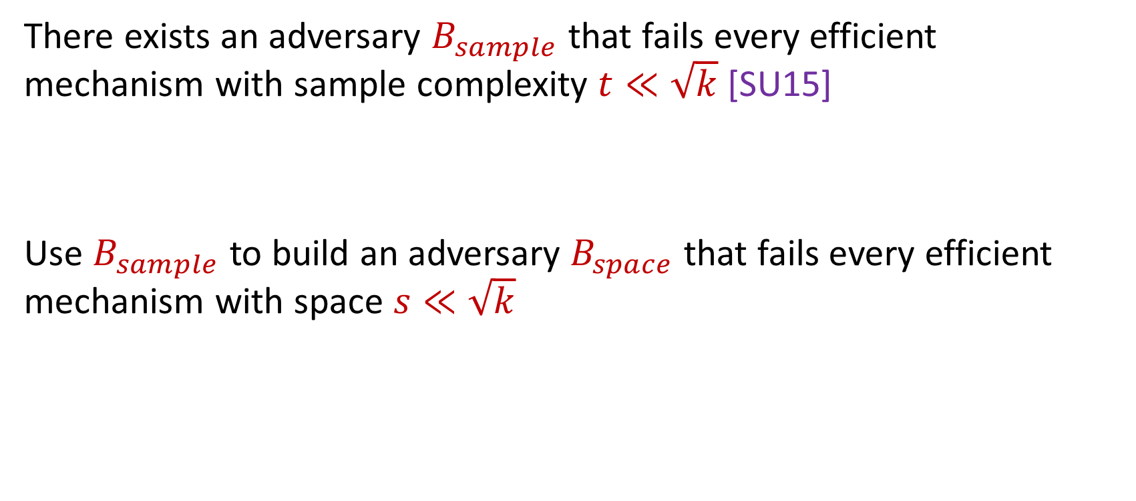
Proof Sketch
There exists an adversary $B_{sample}$ that fails every efficient mechanism with sample complexity $t≪\sqrt{k}$ [SU15]
Use $B_{sample}$ to build an adversary $B_{space}$ that fails every efficient mechanism with space $s≪\sqrt{k}$
Notes:
[DworkMcSherryNissimSmith06]

Slide 49
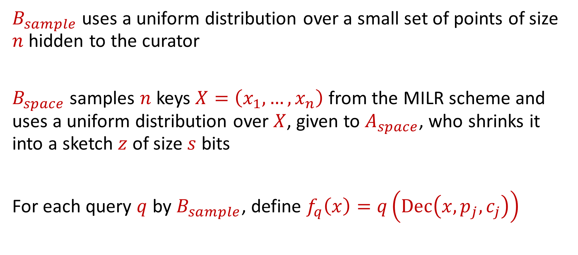
Proof Sketch
$B_{sample}$ uses a uniform distribution over a small set of points of size $n$ hidden to the curator
$B_{space}$ samples $n$ keys $X=\left(x_{1},…,x_{n}\right)$ from the MILR scheme and uses a uniform distribution over $X$, given to $A_{space}$, who shrinks it into a sketch $z$ of size $s$ bits
For each query $q$ by $B_{sample}$, define $f_{q}\left(x\right)=q\left(Dec\left(x,p_{j},c_{j}\right)\right)$
Notes:
[DworkMcSherryNissimSmith06]

Slide 50
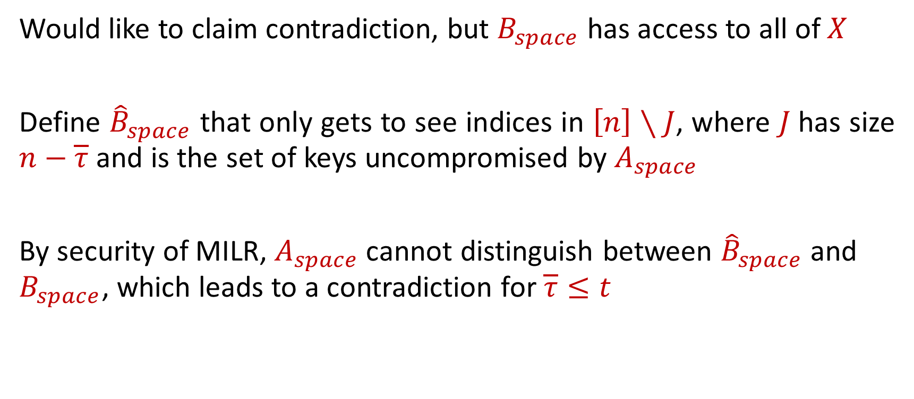
Proof Sketch
Would like to claim contradiction, but $B_{space}$ has access to all of $X$
Define ${\hat{B}}_{space}$ that only gets to see indices in $\left[n\right]∖J$, where $J$has size $n−\overline{τ}$ and is the set of keys uncompromised by $A_{space}$
By security of MILR, $A_{space}$ cannot distinguish between ${\hat{B}}_{space}$ and $B_{space}$, which leads to a contradiction for $\overline{τ}≤t$
Notes:
[DworkMcSherryNissimSmith06]

Slide 51

MILR Construction
Given an encryption scheme $Π^{′}=(Gen^{′},Enc^{′},Dec^{′})$ and $λ=poly(λ^{′})$, contrast an MILR scheme as follows:
Gen: On input $1^{λ}$, return $x←_{R}{\left\{0, 1\right\}}^{λ}$
Param: On input $1^{λ}$, generate a family $G$ of universal hash functions with domain ${\left\{0, 1\right\}}^{λ}$ and range ${\left\{0, 1\right\}}^{λ^{′}}$
Enc: On input $(x,p,m)$, let $x^{′}=g(x)$ for $g$ described by $p$and return $Enc′(x^{′},m)$
Dec: On input $(x,p,c)$, let $x^{′}=g(x)$ for $g$ described by $p$and return $Dec′(x^{′},c)$
Notes:
[DworkMcSherryNissimSmith06]

Slide 52


$k$-Bit Fixing Sources
An $(n,2^{λ})$-source is a random variable $X$ with range ${\left({\left\{0, 1\right\}}^{λ}\right)}^{n}$ and is called $k$-bit fixing if is fixed on at most $k$ coordinates and uniform on the rest
Notes:
[DworkMcSherryNissimSmith06]

Slide 53


Closeness to Convex Combination of $k$-Bit Fixing Sources
Let $F:{\left({\left\{0, 1\right\}}^{λ}\right)}^{n}→{\left\{0,1\right\}}^{s}$ be an arbitrary function and $X=\left(X_{1},…,X_{n}\right)∼ {\left({\left\{0, 1\right\}}^{λ}\right)}^{n}$ and let $Z=F\left(X\right)$.
Let $H$ be a family of universal hash functions with domain ${\left\{0,1\right\}}^{λ}$ and range ${\left\{0,1\right\}}^{λ^{′}}$ and let $G∼H^{n}$.
There exists a family $V_{G,Z}$ of convex combinations of $k$-bit fixing $\left(n,2^{0.1λ}\right)$-sources for $k=\frac{2s}{λ}+4$ with
$$Δ\left[\left(G,Z,G\left(X\right)\right),\left(G,Z,V_{G,Z}\right)\right]≤2^{−0.1λ}$$
Notes:
[DworkMcSherryNissimSmith06]

Slide 54

Closeness to Convex Combination of $k$-Bit Fixing Sources
“Even if we give the adversary a leakage $z∈{\left\{0,1\right\}}^{s}$, hash functions $\vec{g}$ and all the remaining keys, there is a subset of keys that is almost jointly uniformly distributed, i.e., the distribution of the hashed keys$\vec{g}(X)$ is (close to) a convex combinations of $k$-bit-fixing sources”
Proof uses a variant of the leftover hash lemma
Notes:
[DworkMcSherryNissimSmith06]

Slide 55

Multi-Security Against Bounded Pre-Processing Adversary
For a fixed $k$-bit fixing source, the remaining hashed keys are uniformly distributed from the adversary’s view, security with respect to these keys follows from the semantic security of the underlying encryption scheme
Notes:
[DworkMcSherryNissimSmith06]

Slide 56

Applications to Communication Complexity
Suppose ANY sampling based protocol for computing $f(A,B)$ requires $k$ samples $\left(a_{1},b_{1}\right),…, \left(a_{k}, b_{k}\right)$ and $a_{i}∈{\left\{0,1\right\}}^{t}$ for each $i∈[k]$
Notes:
[DworkMcSherryNissimSmith06]

Slide 57









Applications to Communication Complexity
$$a_{1}∈{\left\{0,1\right\}}^{t}$$
$$b_{1}∈{\left\{0,1\right\}}^{∗}$$
$$a_{2}∈{\left\{0,1\right\}}^{t}$$
$$b_{2}∈{\left\{0,1\right\}}^{∗}$$
$$⋮$$
$$⋮$$
$$a_{k}∈{\left\{0,1\right\}}^{t}$$
$$b_{k}∈{\left\{0,1\right\}}^{∗}$$
If a sampling protocol requires $k=Ω(η^{2}n)$ samples for success probability $\frac{1}{2}+\frac{η}{2}$, then any one-way protocol must use $Ω(η^{2}nt)$ communication for success probability $\frac{1}{2}+η$
Notes:
[DworkMcSherryNissimSmith06]

Slide 58

Summary
Introduce and construct multi-instance leakage resilience scheme
For the decoded average vector problem, any CDP algorithm requires $\tilde{Ω}\left(\sqrt{d}\right)$ space in the streaming model, while there exists a non-private algorithm that uses $O(λ\log{d})$ space
Every computationally efficient mechanism that is $(0.1, 0.1)$-accurate for $k$ queries must have space complexity at least $Ω(\sqrt{k})$, assuming the existence of one-way functions
Notes:
[DworkMcSherryNissimSmith06]

Slide 59
Future Directions
Separations for differential privacy and adaptive data analysis without computational assumptions
Separation for differential privacy with a more “natural” problem
Additional applications of MILR
Notes:
[DworkMcSherryNissimSmith06]

Slide 60


Slide 61

Multi-Security Against Bounded Pre-Processing Adversary
An $(n,2^{λ})$-source is a random variable $X$ with range ${\left({\left\{0, 1\right\}}^{λ}\right)}^{n}$ and is called:
$(1−δ)$-dense if for every subset $I⊆[n]$, $H_{∞}\left(X_{I}\right)≥\left(1−δ\right)⋅\left|I\right|⋅λ$
$(k,1−δ)$-dense if is fixed on at most $k$ coordinates and $(1−δ)$-dense on the rest
$k$-bit fixing if is fixed on at most $k$ coordinates and uniform on the rest
Notes:
[DworkMcSherryNissimSmith06]

